Slide 1
Simple(r) Neuron models
BT6270 Introduction to Computational Neuroscience

Slide 2
Outline
Izhikevich neuron models (2 variables)
Quadratic integrate and fire neuron model (1 variable)
Leaky Integrate and Fire neuron model (1 variable)
Dynamic neuron model (1 variable)
Static neuron model (1 variable)

Slide 4
A simplified 2-dimensional model
Three models discussed previously have following common feature,
Resting state for I = 0
Spikes/oscillations/limit cycles for a sufficiently large I.
An N-shaped V-nullcline. The shape of the second nullcine is linear in the FN model, and sigmoidal in ML and INAPK model.
The intersection between the V-nullcine and the second nullcline near the U-shaped, lower arch of the V-nullcline plays a crucial role in neuron dynamics.

Slide 5
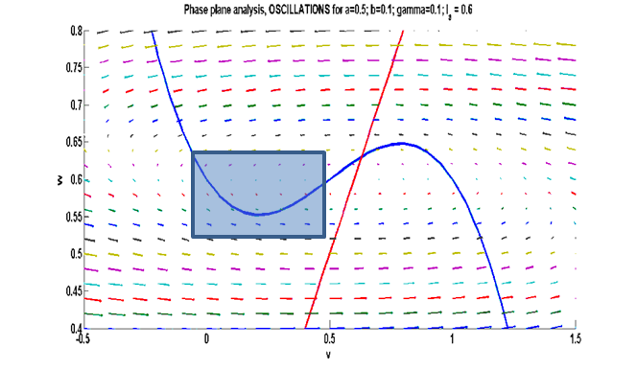
Figure 5.4.1 : Area of interest for the upstroke: Phase plane analysis- Oscillations (FN model) at a=0.5; b = 0.1; r=0.1; I_{a}=0.6

Slide 6
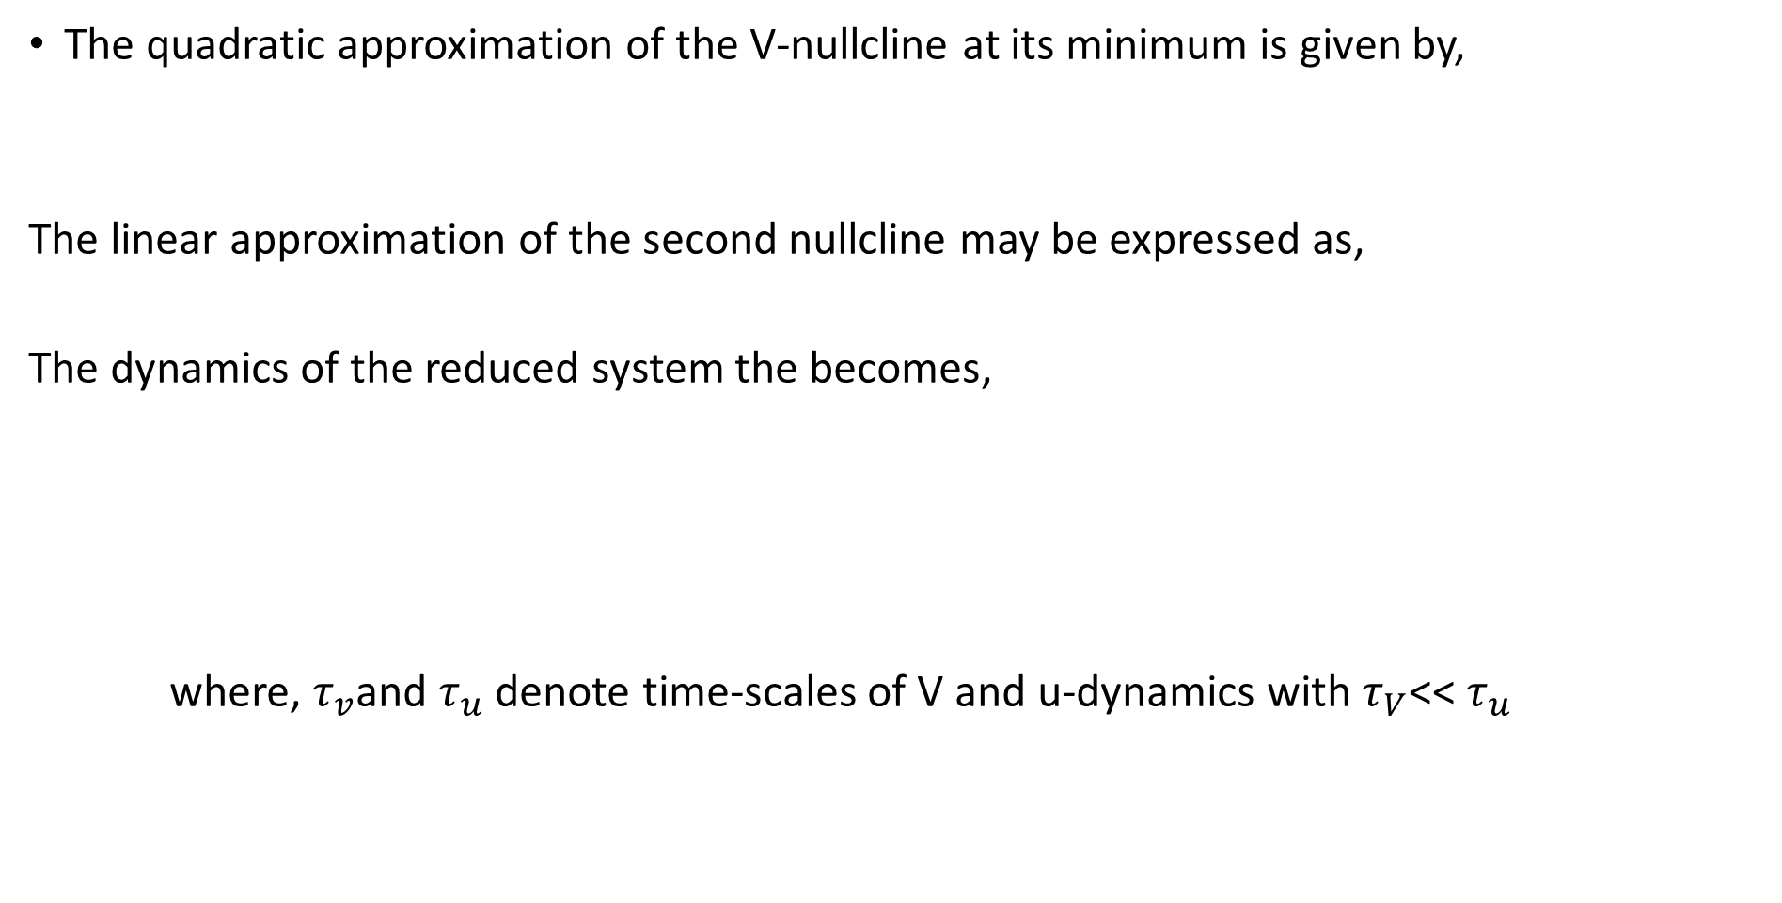
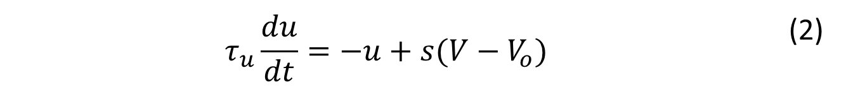

The quadratic approximation of the V-nullcline at its minimum is given by,
The linear approximation of the second nullcline may be expressed as,
The dynamics of the reduced system the becomes,
where, $τ_{v}$and $τ_{u}$ denote time-scales of V and u-dynamics with $τ_{V}$<< $τ_{u}$
$$u=u_{min}+p{(V−V_{min})}^{2}$$ | (1)
$u=s\left(V−V_{o}\right)$ | (2)
$$τ_{v}\frac{dV}{dt}=−u+u_{min}+p{\left(V−V_{min}\right)}^{2}$$ | (3)
$$τ_{u}\frac{du}{dt}=−u+s(V−V_{o})$$ | (2)

Slide 7
V reaches infinity in a finite time

Slide 9
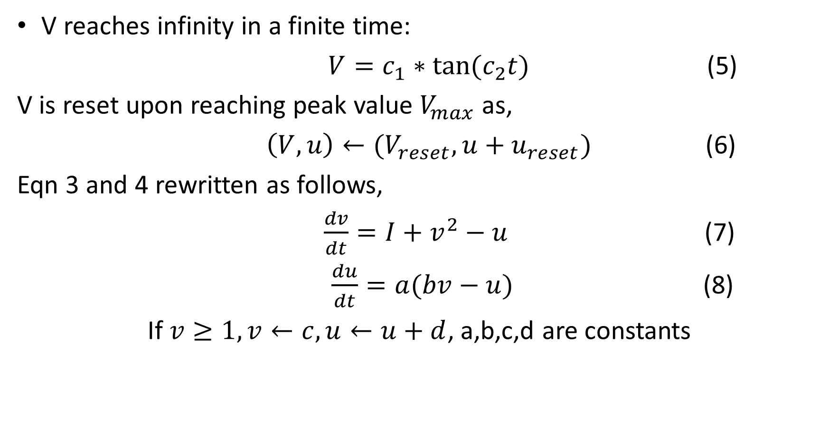
V reaches infinity in a finite time:
$V=c_{1}∗tan⁡(c_{2}t)$ (5)
V is reset upon reaching peak value $V_{max}$as,
$\left(V,u\right)←(V_{reset},u+u_{reset})$ (6)
Eqn 3 and 4 rewritten as follows,
$\frac{dv}{dt}=I+v^{2}−u$ (7)
$\frac{du}{dt}=a(bv−u)$ (8)
If $v≥1,v←c,u←u+d$, a,b,c,d are constants

Slide 10
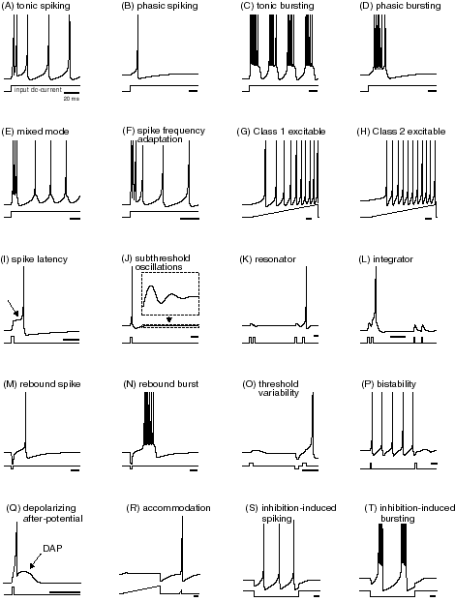
Transient

Slide 11
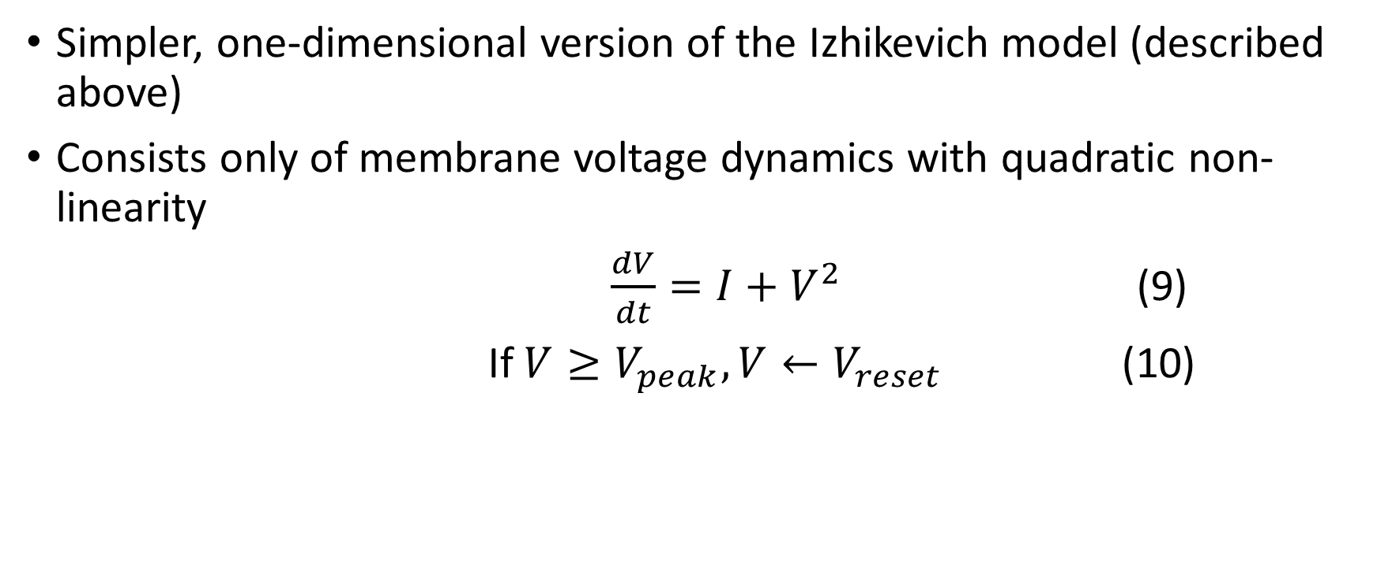
Quadratic Integrate and fire neuron (1 variable)
Simpler, one-dimensional version of the Izhikevich model (described above)
Consists only of membrane voltage dynamics with quadratic non-linearity
$\frac{dV}{dt}=I+V^{2}$ (9)
If $V≥V_{peak},V←V_{reset}$ (10)

Slide 13
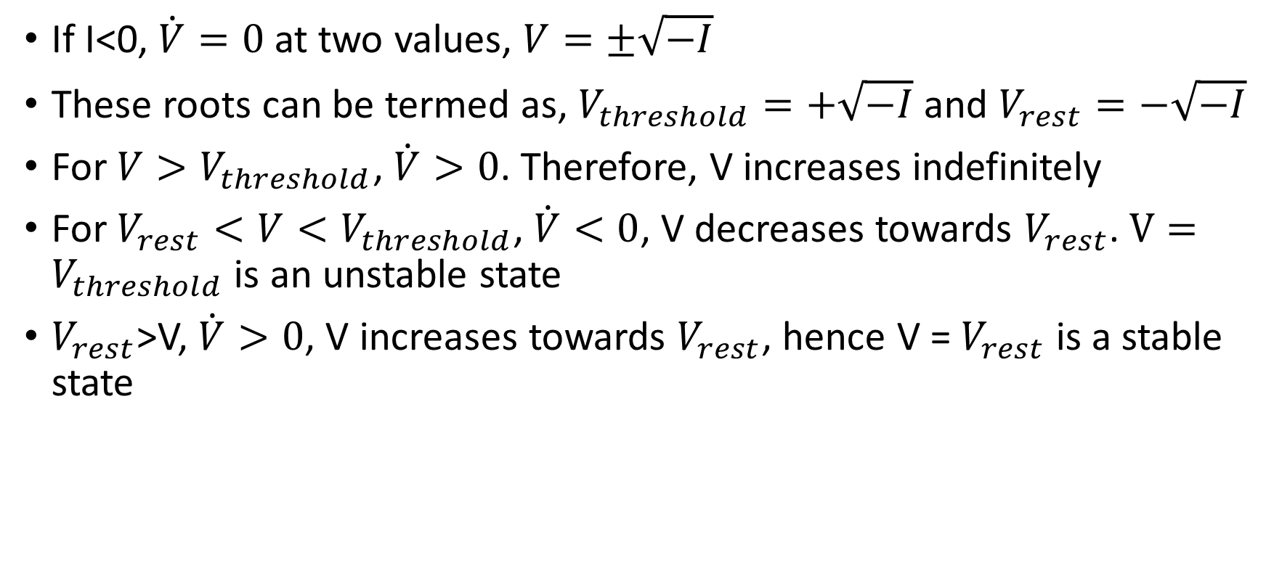
If I<0, $\dot{V}=0$ at two values, $V=±\sqrt{−I}$
These roots can be termed as, $V_{threshold}=+\sqrt{−I}$ and $V_{rest}=−\sqrt{−I}$
For $V>V_{threshold}$, $\dot{V}>0$. Therefore, V increases indefinitely
For $V_{rest}<V<V_{threshold}$, $\dot{V}<0$, V decreases towards $V_{rest}$. $V=V_{threshold}$ is an unstable state
$V_{rest}$>V, $\dot{V}>0$, V increases towards $V_{rest}$, hence V = $V_{rest}$ is a stable state

Slide 14
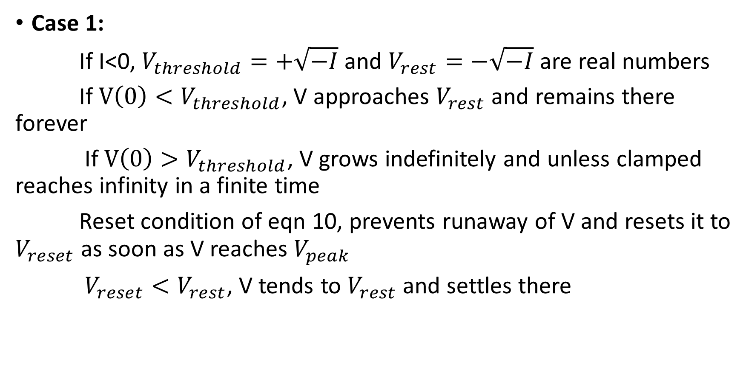
Case 1:
If I<0, $V_{threshold}=+\sqrt{−I}$ and $V_{rest}=−\sqrt{−I}$ are real numbers
If $V\left(0\right)<V_{threshold}$, V approaches $V_{rest}$ and remains there forever
If $V\left(0\right)>V_{threshold}$, V grows indefinitely and unless clamped reaches infinity in a finite time
Reset condition of eqn 10, prevents runaway of V and resets it to $V_{reset}$ as soon as V reaches $V_{peak}$
$V_{reset}<V_{rest}$, V tends to $V_{rest}$ and settles there

Slide 15
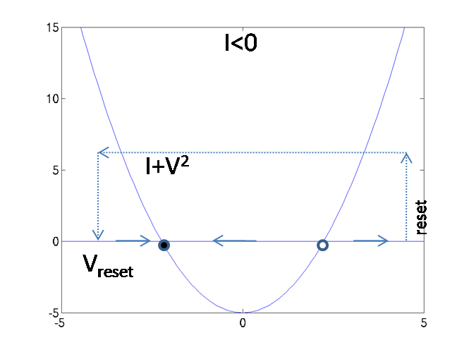
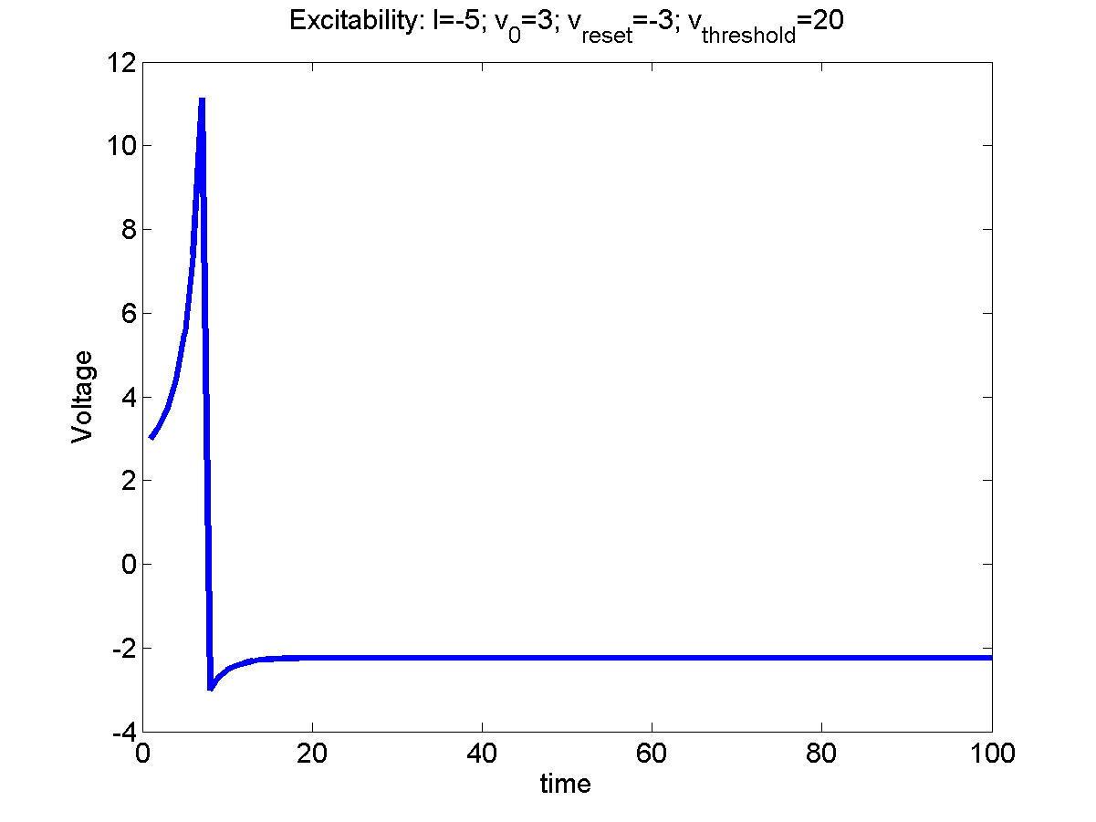
V_{thresh}
Figure 5.4.1.1: a) Reset condition b) Voltage simulation at I = -5; v_{o} = 3; v_{reset} = -3; v_{thresh} = 11;

Slide 16
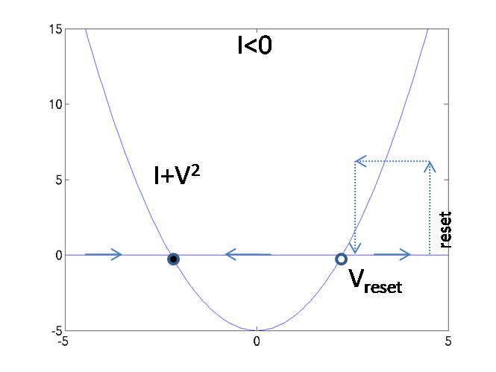
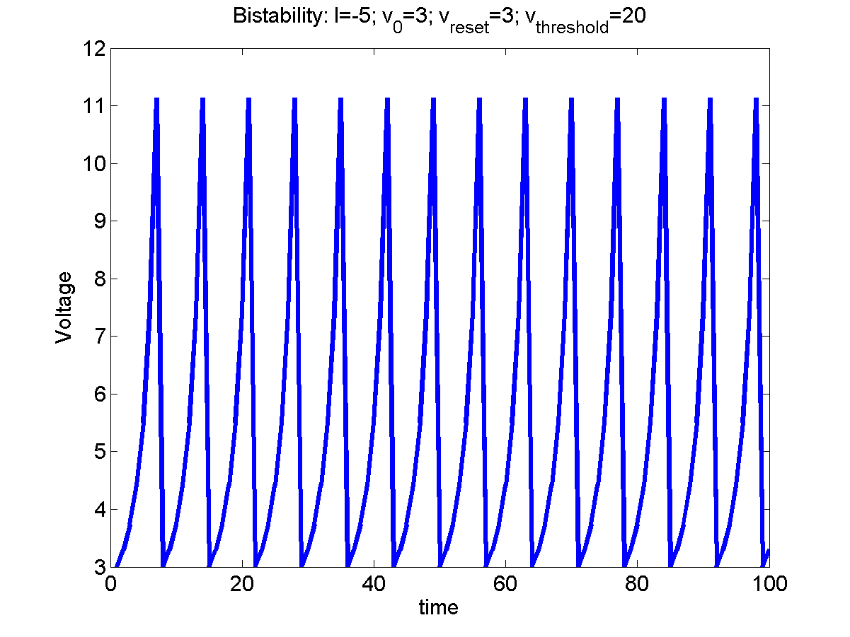
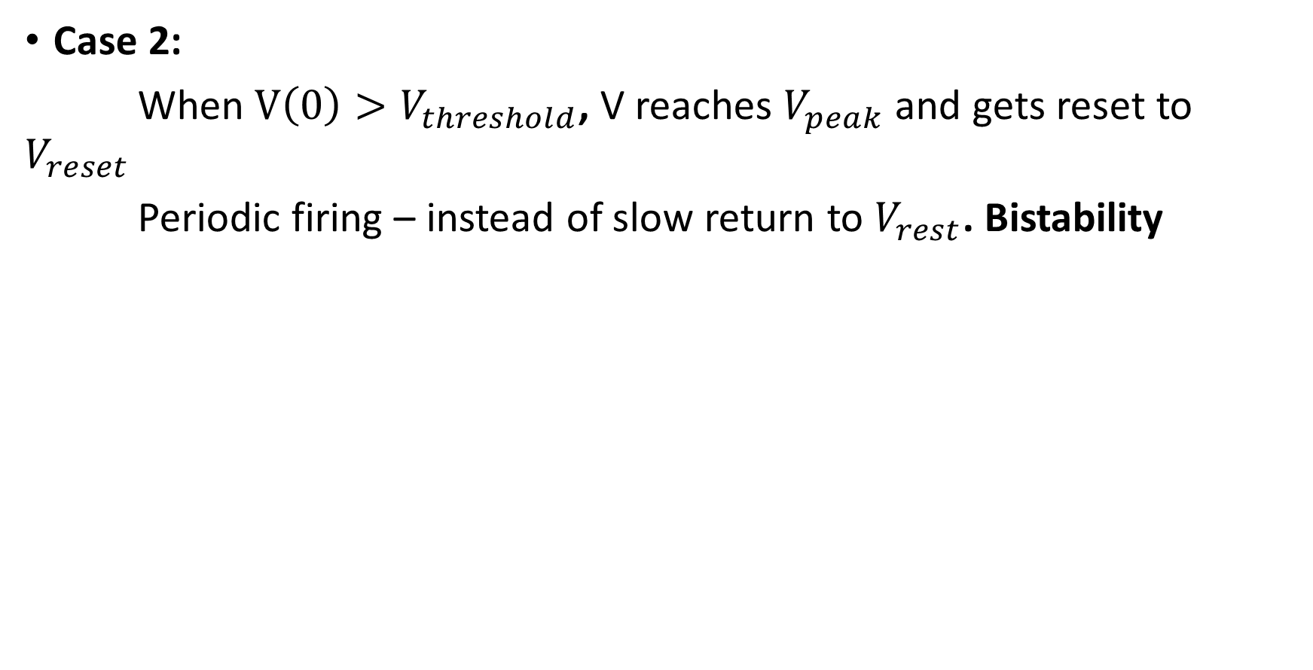
Case 2:
When $V\left(0\right)>V_{threshold}$, V reaches $V_{peak}$ and gets reset to $V_{reset}$
Periodic firing – instead of slow return to $V_{rest}$. Bistability
Figure 5.4.1.2: a) Reset condition b) Voltage simulation at I = -5; v_{o} = 3; v_{reset} = 3; v_{threshold} = 11;

Slide 17
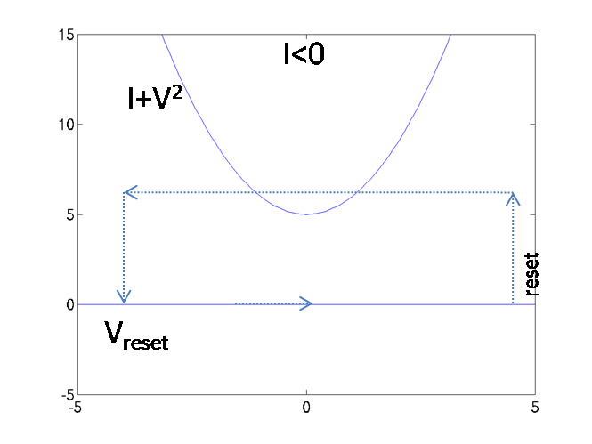
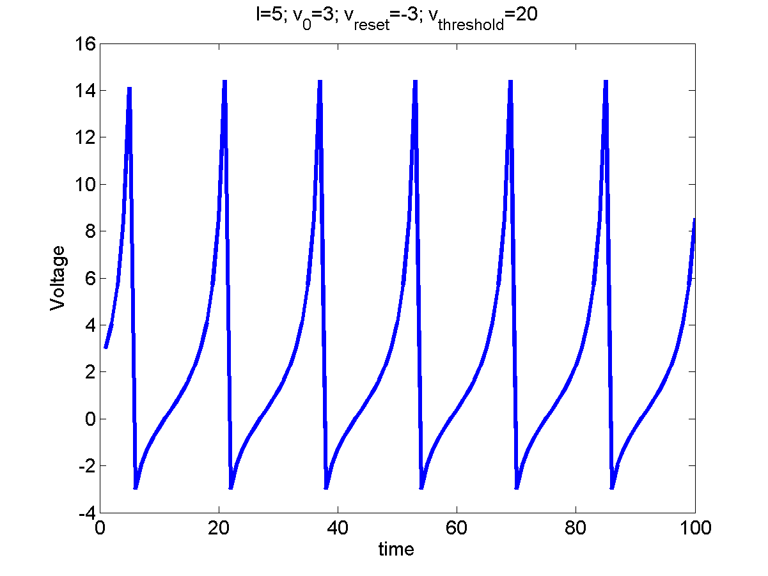
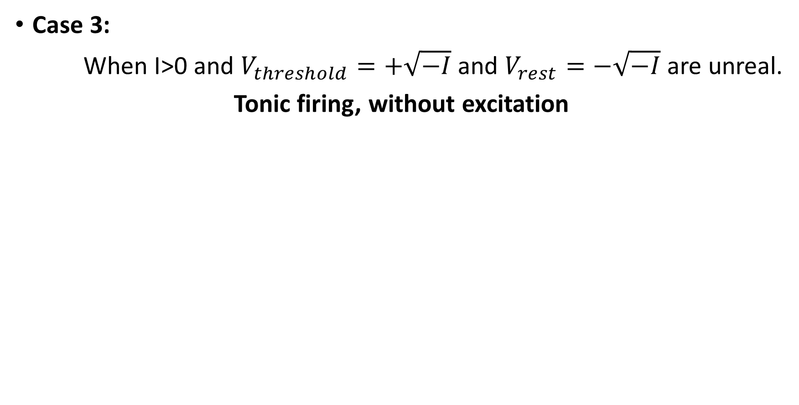
Case 3:
When I>0 and $V_{threshold}=+\sqrt{−I}$ and $V_{rest}=−\sqrt{−I}$ are unreal.
Tonic firing, without excitation
Figure 5.4.1.3: a) Reset condition b) Voltage simulation at I = 5; v_{o} = 3;

Slide 19

Leaky Integrate and Fire neuron
I_{ext}(t)
V_{th}
R
C
Figure 5.4.2.1: Leaky Integrate and Fire circuit diagram
Applying Kirchoff’s Current Law,
$C\frac{dV}{dt}+\frac{V}{R}=I_{ext}(t)$ (11)
If V(t) = θ, V(t) = 0 (reset)

Slide 21
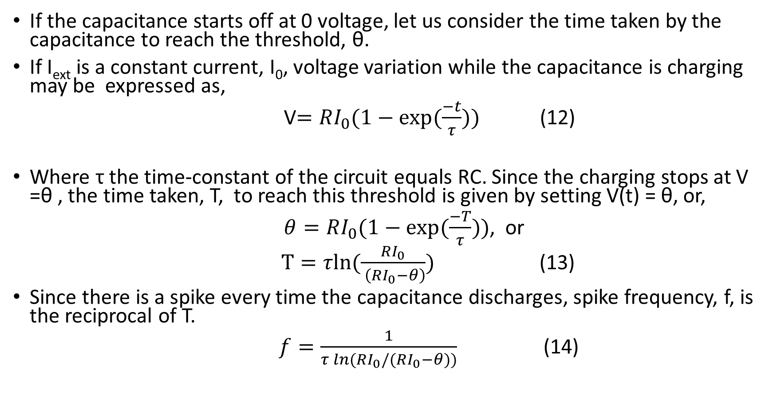
If the capacitance starts off at 0 voltage, let us consider the time taken by the capacitance to reach the threshold, θ.
If I_{ext} is a constant current, I₀, voltage variation while the capacitance is charging may be expressed as,
V$=RI_{0}(1−exp⁡(\frac{−t}{τ}))$ (12)
Where τ the time-constant of the circuit equals RC. Since the charging stops at V =θ , the time taken, T, to reach this threshold is given by setting V(t) = θ, or,
$θ=RI_{0}(1−exp⁡(\frac{−T}{τ}))$, or
$T=τln⁡(\frac{RI_{0}}{ \left(RI_{0}−θ\right)})$ (13)
Since there is a spike every time the capacitance discharges, spike frequency, f, is the reciprocal of T.
$f=\frac{1}{τ\ln{(}RI_{0}/(RI_{0}−θ))}$ (14)

Slide 22
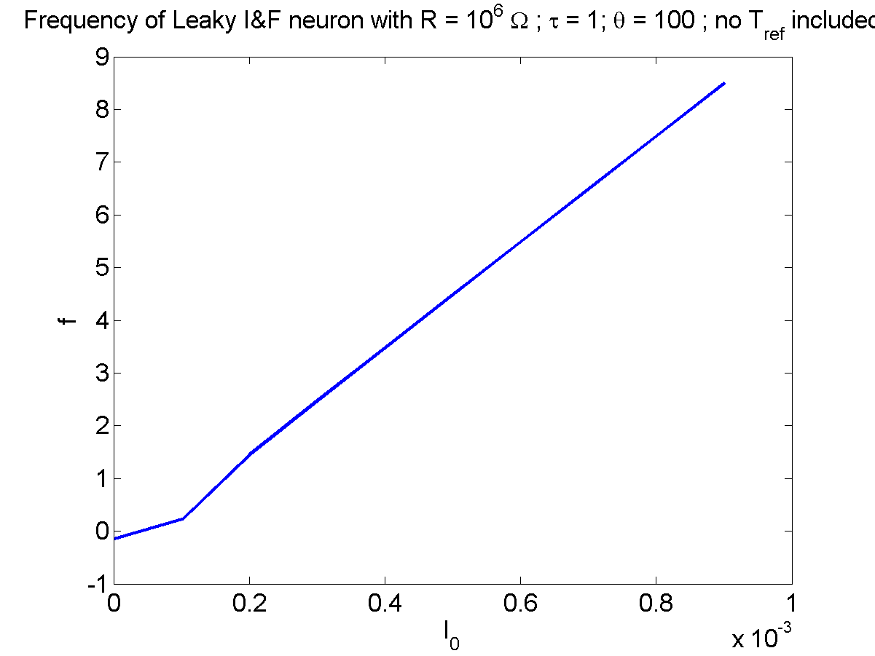
Figure 5.4.2.2: frequency vs I_{o} without inclusion of absolute refractory period

Slide 23
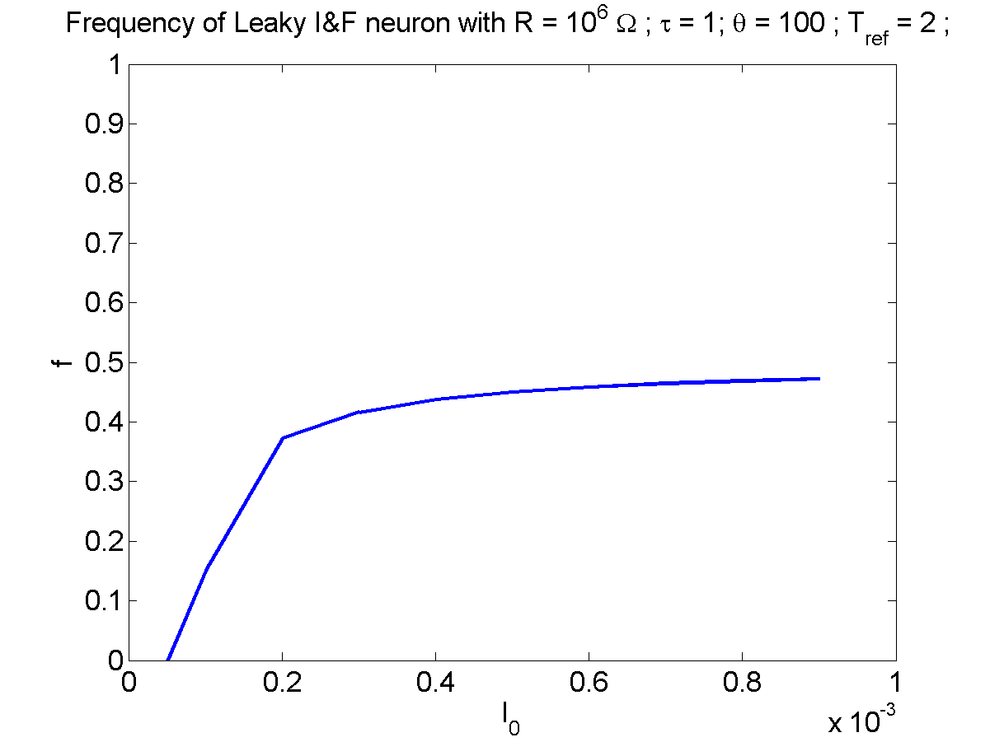
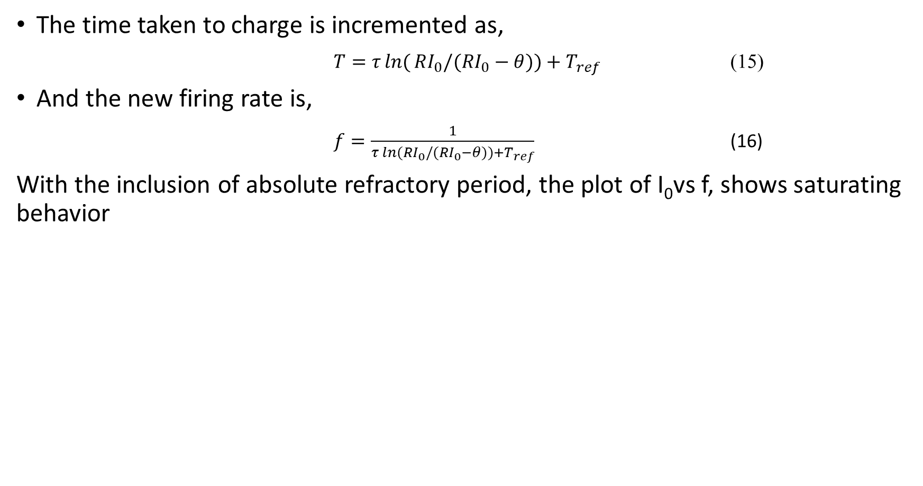
The time taken to charge is incremented as,
$T=τ\ln{(}RI_{0}/(RI_{0}−θ))+​T_{ref}$ (15)
And the new firing rate is,
$f=\frac{1}{τ\ln{(}RI_{0}/(RI_{0}−θ))+T_{ref}}$ (16)
With the inclusion of absolute refractory period, the plot of I₀vs f, shows saturating behavior
Figure 5.4.2.3: frequency vs I_{o} with inclusion of absolute refractory period

Slide 24
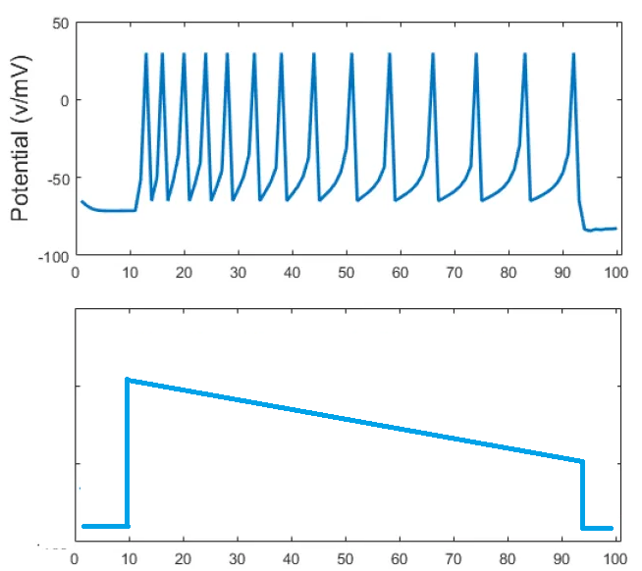
What is the Neural Code? Two theories -
Spike code
Rate Code
Information is present in the times of occurrence of the spikes
Information is present in the frequency (rate) of the spikes
Spike code
Rate code

Slide 25
Rate-coded neuron models

Slide 27
Binary Neuron Models
To simplify the single neuron model further, we may consider rate-coded models which represent the neuron state in terms of the spike rate.
These models typically describe neurons as binary elements, with a high (excited state) and a low (resting) state.

Slide 28
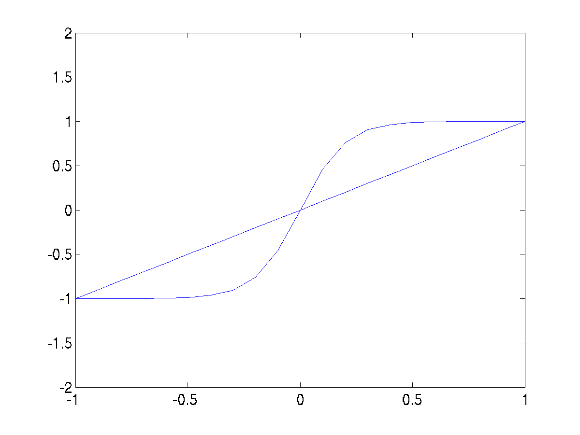
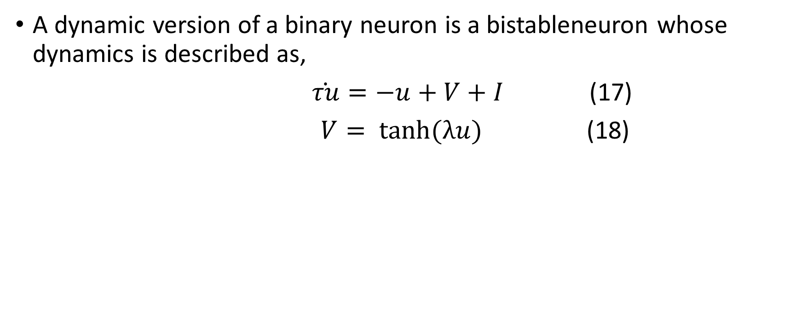
Dynamic Binary Neuron Model
A dynamic version of a binary neuron is a bistableneuron whose dynamics is described as,
$\dot{τu}=−u+V+I$ (17)
$V= \tanh{(λu)}$ (18)
Figure 5.4.3.1.1: u,v nullclines

Slide 30
V is an abstract quantity that denotes if the neuron is excited (V is close to 1) or in the resting state (V is close to -1).
For I = 0 and l> 1, the above system has three fixed points. The fixed point at the origin can be shown to be unstable, while the ones on the flanks can be shown to be stable. When released from a random initial condition, the neuron state, V, settles near +1 or -1.
For I > b, where b = 2.63, and l> 1, Eqn 17 above has only a single, stable fixed point at V close to +1.
For I < -b, and l> 1, eqn 17 above has only a single, stable fixed point at V close to -1.
For –b < I < b, there are again three fixed points, two close to + 1 and -1 respectively, and the third somewhere in the middle, not necessarily at the origin.
The above neuron model also shows hysteresis effect. If I is reduced from a large positive value to a large negative value and back, the points at which V makes transitions from (+1 to -1 and vice versa) are different in the forward pass and the reverse pass.

Slide 31
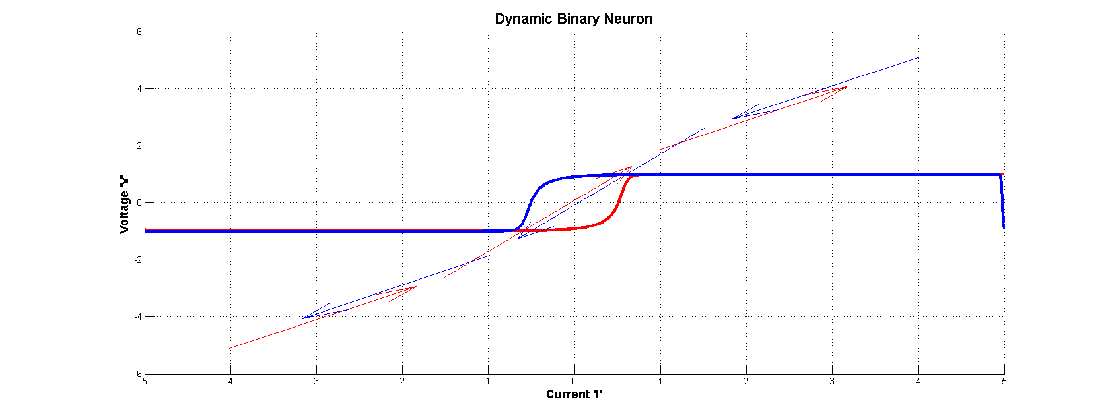
Figure 5.4.3.1.2 : Hysteresis curve for a dynamic binary neuron

Slide 32
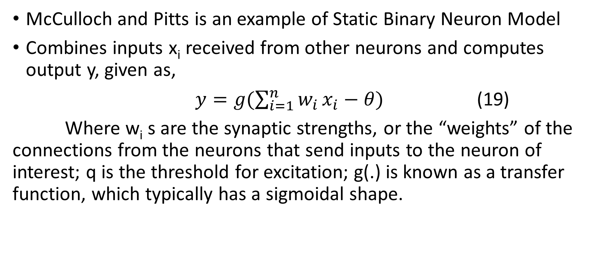
Static Binary Neuron Model
McCulloch and Pitts is an example of Static Binary Neuron Model
Combines inputs x_{i} received from other neurons and computes output y, given as,
$y=g(\sum_{i=1}^{n}{w_{i}}x_{i}−θ)$ (19)
Where w_{i} s are the synaptic strengths, or the “weights” of the connections from the neurons that send inputs to the neuron of interest; q is the threshold for excitation; g(.) is known as a transfer function, which typically has a sigmoidal shape.

Slide 33
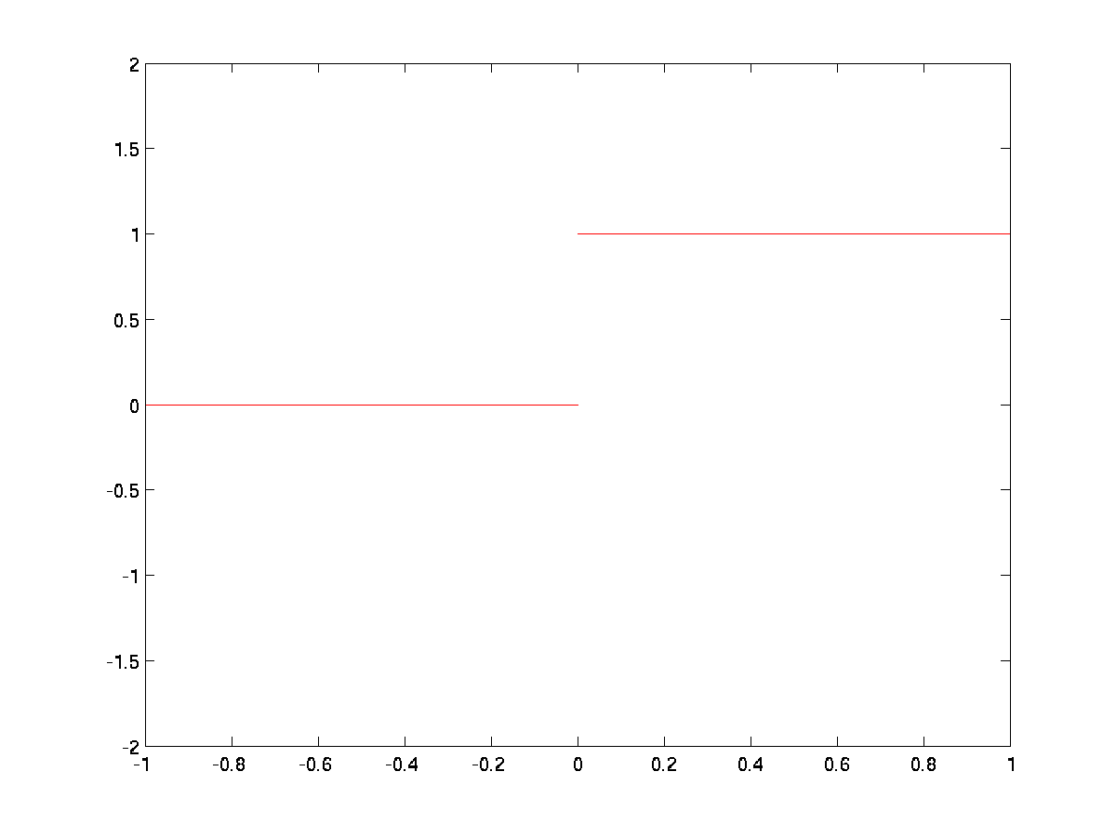
Hardlimiting nonlinearity:
y = 1/0:

Slide 34
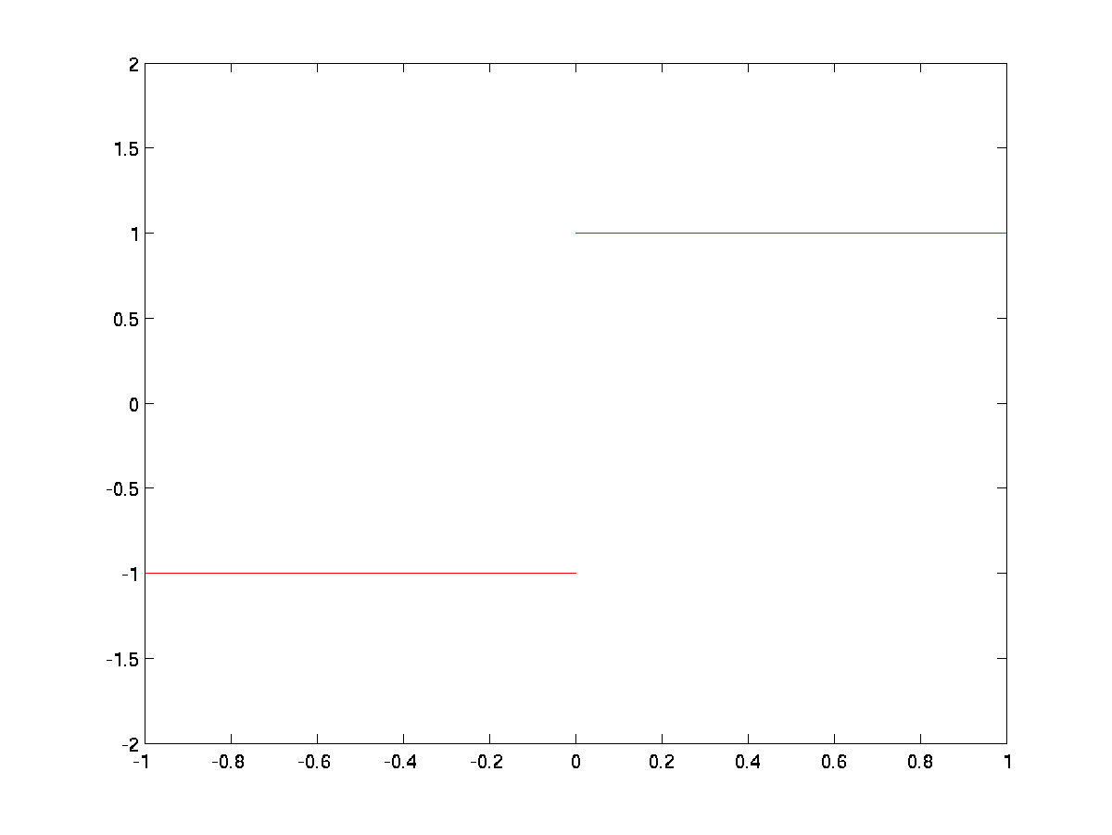
Hardlimiting nonlinearity:
y = +1:

Slide 35
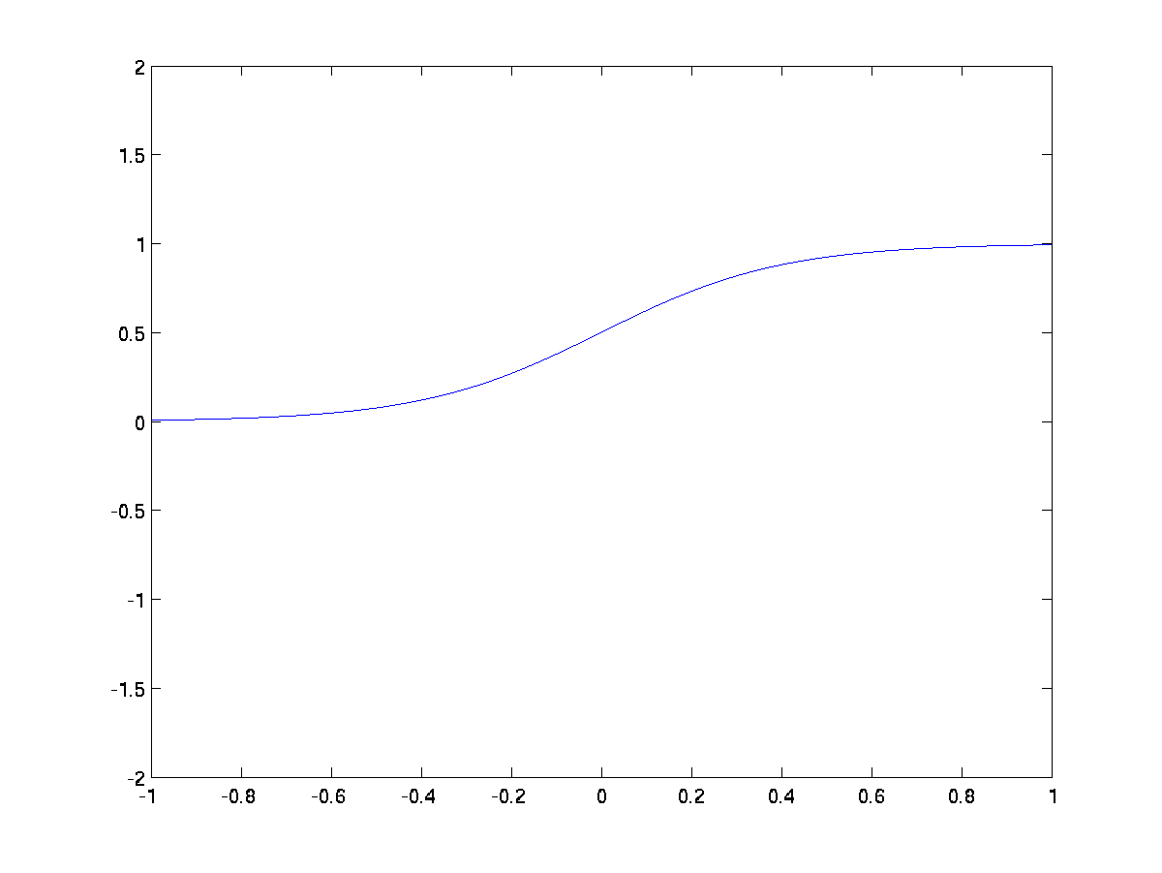
Smooth Sigmoid nonlinearity:
Logistic function, y ϵ (0,1)

Slide 36
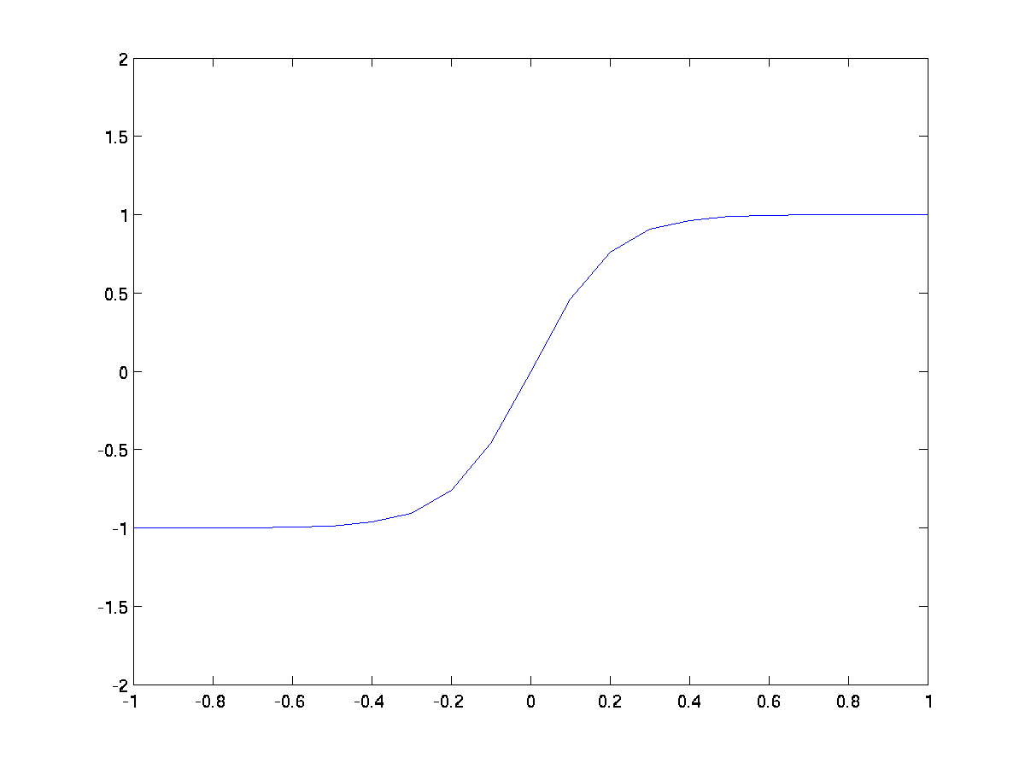
Smooth Sigmoid nonlinearity:
Tanh(.) function, y ϵ (-1,1)

Slide 37
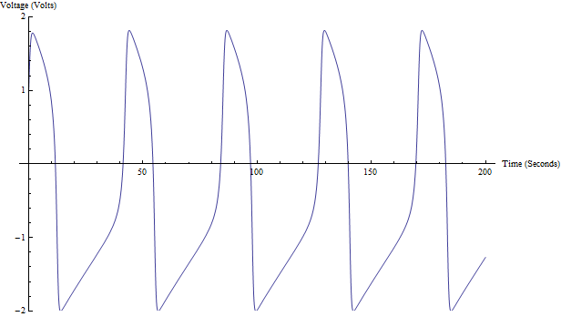
Oscillator neuron models – 2 variable models
FitzHugh – Nagumo model
Morris-Lecar model
INapK model
FN model – Action Potentials

Slide 38
Spiking neuron models
Izhikevich 2 variable model
Quadratic integrate and fire model
Leaky Integrate and fire model

Slide 39
Rate coded neuron models
Dynamic binary neuron with bistability
Sigmoidal static neuron
McCulloch-Pitts neuron (including inputs from other neurons)

Slide 40
References:
E. M. Izhikevich, J. A. Gally, and G. M. Edelman, “Spike-timing dynamics of neuronal groups,” Cerebral Cortex, vol. 14, pp. 933–944,2004.
E. M. Izhikevich, N. S. Desai, E. C. Walcott, and F. C. Hoppensteadt, “Bursts as a unit of neural information: Selective communication via resonance ,” Trends Neurosci., vol. 26, pp. 161–167, 2003.
E. M. Izhikevich, “Simple model of spiking neurons,” IEEE Trans. Neural Networks, vol. 14, pp. 1569–1572, Nov. 2003.
Latham, P. E., B. J. Richmond, P. G. Nelson, and S. Nirenberg. (2000). "Intrinsic Dynamics in Neuronal Networks. I. Theory.". Journal of Neurophysiology 88 (2): 808–27.

